Slide 1
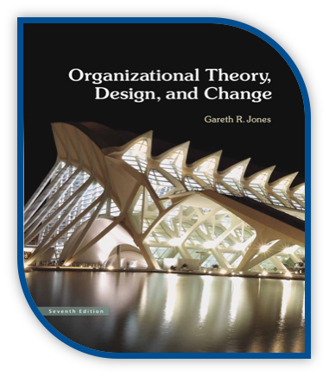
MSCI 311
Organizational Design and Technology
Instructor: Ayman Alzayat, aalzayat@uwaterloo.ca
TA: Varsha Suryanarayana, vsuryana@uwaterloo.ca

Slide 2

Organizational Goals and Effectiveness
(Chapter 2 and 5 in the textbook)

Slide 3
Goals
Types of goals and their function
The process of goal setting
Challenges of goal setting

Slide 4
Goals
Introduction
Recall tentative definition of organizations as ‘a group of people working together towards a common goal’
Recall problems with the definition.
Definition of Goal: “A desirable state in the future”
The nature of goals and sub goals that they are hierarchical.

Slide 5
Goals
Official Goals
Definition: “the general purposes of the organization as put forth in the charter, annual reports, public statements by key executives and other authoritative pronouncements”.
In this sense official goals are indistinguishable as a concept from mission statements.
What are the official goals of the University of Waterloo?

Slide 6
Goals
Official Goals – Characteristics
Purposefully vague and general
Legitimize the organization
Emphasize values
Not measurable
Do not describe
Decisions to be made to achieve goals
The priority of multiple goals
Unofficial goals pursued by groups within the organization

Slide 7
Goals
Operative Goals
What the organization is actually trying to do; the outcomes it’s actually trying to attain; the ends sought through actual operating procedures
Provide the specific content of official goals – the means to official goals
Reflect choices among competing values
Outcomes that organization seeks to attain
Example: University of Waterloo Strategic Plan

Slide 8
Goals
Functions of Goals
Reduction of uncertainty:
provide direction.
guidelines for action & decision.
act as a constraint.
Creation of legitimacy: internal (employees) and external (stakeholders, clients, etc.)
Evidence that organization is striving towards bettering itself.
Employee motivation
When rewards tied to accomplishment of goal.
Influence organizational design
Goals provide standards for evaluation.

Slide 9
Goals
Functions of Goals
External Environment:
Uncertainty
Outcomes:
Reduction of uncertainty
Creation of Legitimacy
Organizational design
Performance evaluation
Employee Motivation
Top Management
Strategic Direction:
Official goals - Operative goals
Internal Environment

Slide 10
Goals
How are goals set?
Classical theory: hierarchy of organizational goals
Managerial elite uses rational and logical means to pursue ends described in official goals
Problem: Not realistic
Goals
Managerial Elite
Rational &
Logical Means
Clear & Discrete Ends
Workers

Slide 11
Goals
How are goals set?
Carnegie Model: how goals are set in practice
Problem:
Organizational units agree on official (ambiguous) goals
However, they do not agree on sub-goals (or operative goals)
According to this model, the following emerge or must be considered when organizations set goals …

Slide 12
Carnegie Model: how goals are set in practice
Coalitions: clusters of members that share distinct values and interests
Example: departments, managers vs. union
Bargaining
Emerging organizational goals are a result of compromise between various interests groups
Goals are a reflection of power of the various groups
Side payments
Price paid by one coalition to another
Examples: Money, personal treatment, authority, organization policy
Slack
Resulting difference between the total resources thus available to the group and the total payments necessary
Cushion of unused resources.
Example: wages paid above the level necessary to attract an acceptable workforce

Slide 13
Goals
Challenges of goal setting. Why is it difficult?
Goal conflict: Individual goals vs. organizational goals
Individual goals may not necessarily be in alignment with organizational goals.
E.g., personal goal of professional development for an administrative assistant might be in conflict with organizational goals of digitizing all paper records (resulting in a lot of data-entry work for the employee).

Slide 14
Goals
Challenges of goal setting. Why is it difficult?
Goal conflict: Multiple conflicting organizational goals.
Multiple official goals that the organization cannot pursue all at once
E.g., organization doesn’t have the resources to succeed at all goals, or the pursuit of one goal jeopardizes another goal
Inter-departmental goal conflict, arising from interpretation of vague official goals
Departments re-interpret official goals to suit own interests, resulting in conflicting operative goals between departments.
Recall: these conflicts are resolved through bargaining (Carnegie model)

Slide 15
Goals
Challenges of goal setting. Why is it difficult?
Goal displacement occurs when legitimate goal is replaced by another goal.
It may happen as a result of:
Success: achieve official goal - come up with new goal.
Example: March of Dimes
The organization may cease to exist.
Means-end inversion.
The path to the goal becomes the goal itself.
Example: study of nurses.

Slide 16
Goals
Challenges of goal setting. Why is it difficult?
Goal displacement occurs when legitimate goal is replaced by another goal.
It may happen as a result of:
Departmental sub-optimization:
Departments / units give higher priority to own goals.
E.g. manufacturing / design department conflict.
Over-measurement: Focus on aspect of the goal that is easily measurable
Measurable part of original goal becomes new goal
e.g professors are measured by the published papers.

